Slide 1
Accessibility Program Managers Meeting
Performance Measures for Federal Accessibility Programs
Michael Horton | April 8, 2019
Notes:
SAMPLE COVER

Slide 2
Agenda
Overview
Measuring Performance
Hands-on Exercise

Slide 3
Overview
Collaboration:
Challenges:
Opportunities:
Identify the next generation of measurements to determine:
508 Program maturity
Accessibility of ICT
..and use data to find ways to:
Reduce the reporting burden on agencies
Increase the maturity of agencies programs
Increase the number of conformant ICT
Various sizes/maturity levels of 508 Programs
Available resources
Level of understanding
Different users of data
Limits on data reporting
One size does not fit all
Normalized and shared data metrics
Data becomes more actionable by agencies and across government
Opportunity to automate data reporting/analysis
Standard/commonality of policies & processes
Easier for vendors to be accessible
Improve access to ICT

Slide 4
Measuring Performance

Slide 5
Reliability + Validity = Good Data
Reliability refers to the stability and repeatability of a measurement.
Validity refers to the extent to which you are actually measuring what you are intending to measure.

Slide 6
Steps to ensure that data is useful
Develop operational definitions for each data point that you will be using.
Develop specific and precise procedures for collecting and recording the data.

Slide 7
Principles Of Performance Measurement
Know why you are measuring and how it will be used
Measure the critical few and not the trivial many
Measure the drivers of high performance
Use a family of measures
Include internal and external perspectives of performance
Give feedback to those supplying the data

Slide 8
Principles Of Performance Measurement
Continued
Adjust monetary measures for inflation and “present value” of money
Use measures that are SMART
Specific
Measurable
Actionable
Relevant
Timely

Slide 9
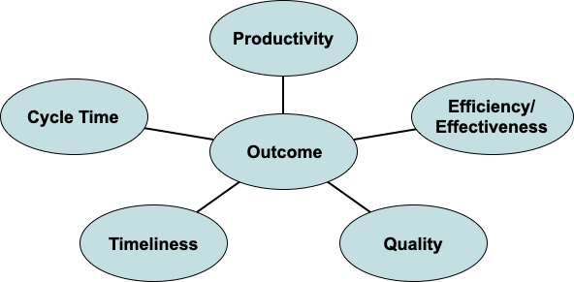
Developing A Family of Measures
Notes:
A combination of performance measures/metrics which, when taken together, provide multiple perspectives on an organization’s achievement of its desired end state.

Slide 10
Logic Model Definition
Logic models are a useful tool for understanding how a program functions and in turn for identifying appropriate measures of performance.
They provide a visual representation of the relationship between each step in the program process.

Slide 11
Logic Model Variables
Inputs - “Raw Materials” that are needed.
Process - What the organization does to transform the raw materials into something the customer needs.
Outputs - The direct products of program activities.
Intermediate outcomes - The immediate results of the outputs.
Outcomes - The realization of the desired and intended purpose of the program.

Slide 12
Logic Model Example
Trusted Tester ICT Evaluation
Trusted Tester
&
Web-based
ICT Product
Trusted Tester Test Process
Compliance Determination Document
Accessible ICT

Slide 13
Maturity Metrics and Measures
OMB Section 508 Program Maturity Metrics
 | Acquisition | Life Cycle Activities | Testing & Evaluation | Complaints Process | Training | Program Management
Ad Hoc: No formal policies, process or procedures defined.
Planned: Policies, processes and procedures defined and communicated. | Y/N | Y/N | Y/N | Y/N | Y/N | Y/N
Resourced: Resources committed and/or staff trained to implement policies, processes and procedures. | # | # | # | # | # | #
Measured: Validation is performed; results are measured and tracked. | # | # | # | # | # | #

Slide 14
Maturity Metrics and Measures
Sample of possible “Planned” metrics
 | Acquisition | Life Cycle Activities | Testing & Evaluation | Complaints Process | Training | Program Management
Ad Hoc: No formal policies, process or procedures defined.
Planned: Policies, processes and procedures defined and communicated. | Exceptions Process in Place IT Acquisition Review Process in Place | Section 508 Review Criteria Institutionalized in EA Process | Agency Approved Testing Processes in Place | Section 508 Complaints Management Plan in Place | Training Plan in Place Communication and Outreach Plan in Place | Dedicated Section 508 Coordinator Section 508 Policy in Place Coordinator Participation in Federal 508 Community

Slide 15
Hands-on Exercise

Slide 16
Hands-on Exercise
Each table, or team, will be assigned a Maturity Metric
Each team will select someone to write down their ideas
Using the logic model, brainstorm on what are the right things to measure in an ideal world; even if you can't right now
Identify a family of performance measures that might provide “good data” to measure program success
Share and discuss the critical few (and collect the trivial many)

Slide 17
What Are Our Key Measurements?
Some suggestions to kickstart your ideas
Program
Governance
Services
Complaints
Staffing
Training
Communication and Outreach
Other…?
Policy
Exceptions
Acquisitions
EA / Life Cycle
Other…?
Testing & Evaluation
Technical Assistance
Accommodation Assistance
Other…?

Slide 18
...and BEGIN!

Slide 19
Now, lets
DISCUSS.

Slide 20
Notes:
Instructions: End slide. This indicates the end of your presentation. End every presentation with this slide so the GSA icon is behind you during Q&A.

